Slide 1
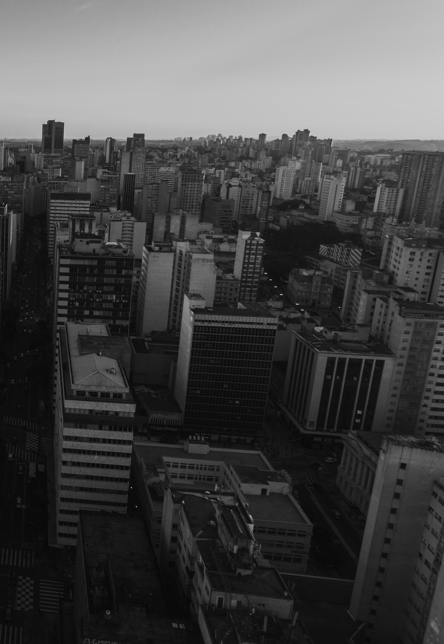
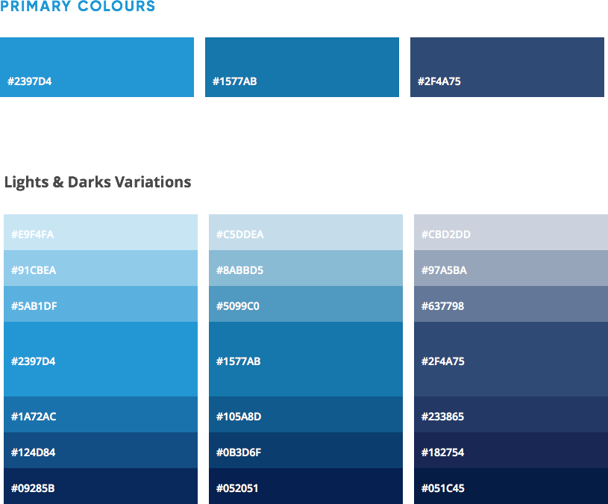


February 21, 2018
Coding Dojo
気合! (KIAI!)

Slide 2
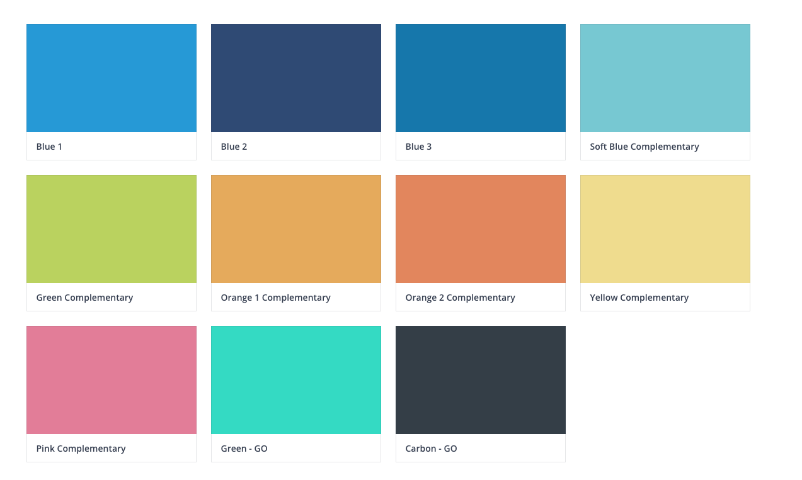
What’s Coding Dojo?
This isn’t a new martial art… Sorry UFC fans! Also not a Framework! (I heard a ‘phew’?)
CODING DOJO
A Coding Dojo is a meeting where a bunch of coders get together to work on a programming challenge.

Slide 3
Premises
Promise me!
CODING DOJO
Acquiring coding skills should be a continuous process. This case will be the Java.

Slide 4
Characteristics
Tinder?
CODING DOJO
Non-competitive, collaborative, fun environment
All skill levels are welcome
Safe to try new ideas

Slide 5
Requirements
Any ideas for a joke here?
CODING DOJO
Meeting room with enough seats (typical attendance varies between 5 and 20 ?)
At least one PC or laptop (or a Mac)
A digital projector (‘beamer’)

Slide 6
Process
Wait, not so fast!
The master offers a challenge to the group. The pilot, seated at the computer, is the only person who can use it to complete the challenge. The co-pilot stays by his side, but only to watch the pilot in action and offer directions. All others observe and can discuss with each other and with the co-pilot and the pilot.
CODING DOJO

Slide 7
Process
Calm down, please!
CODING DOJO
Regardless of the challenge being solved, every five minutes the current pilot returns to the audience, the co-pilot becomes the next pilot, and someone from the audience assumes as co-pilot.

Slide 8
Process
Let me breathe!
CODING DOJO
Finally, with each challenge accomplished, the master offers another, slightly more complex.

Slide 9
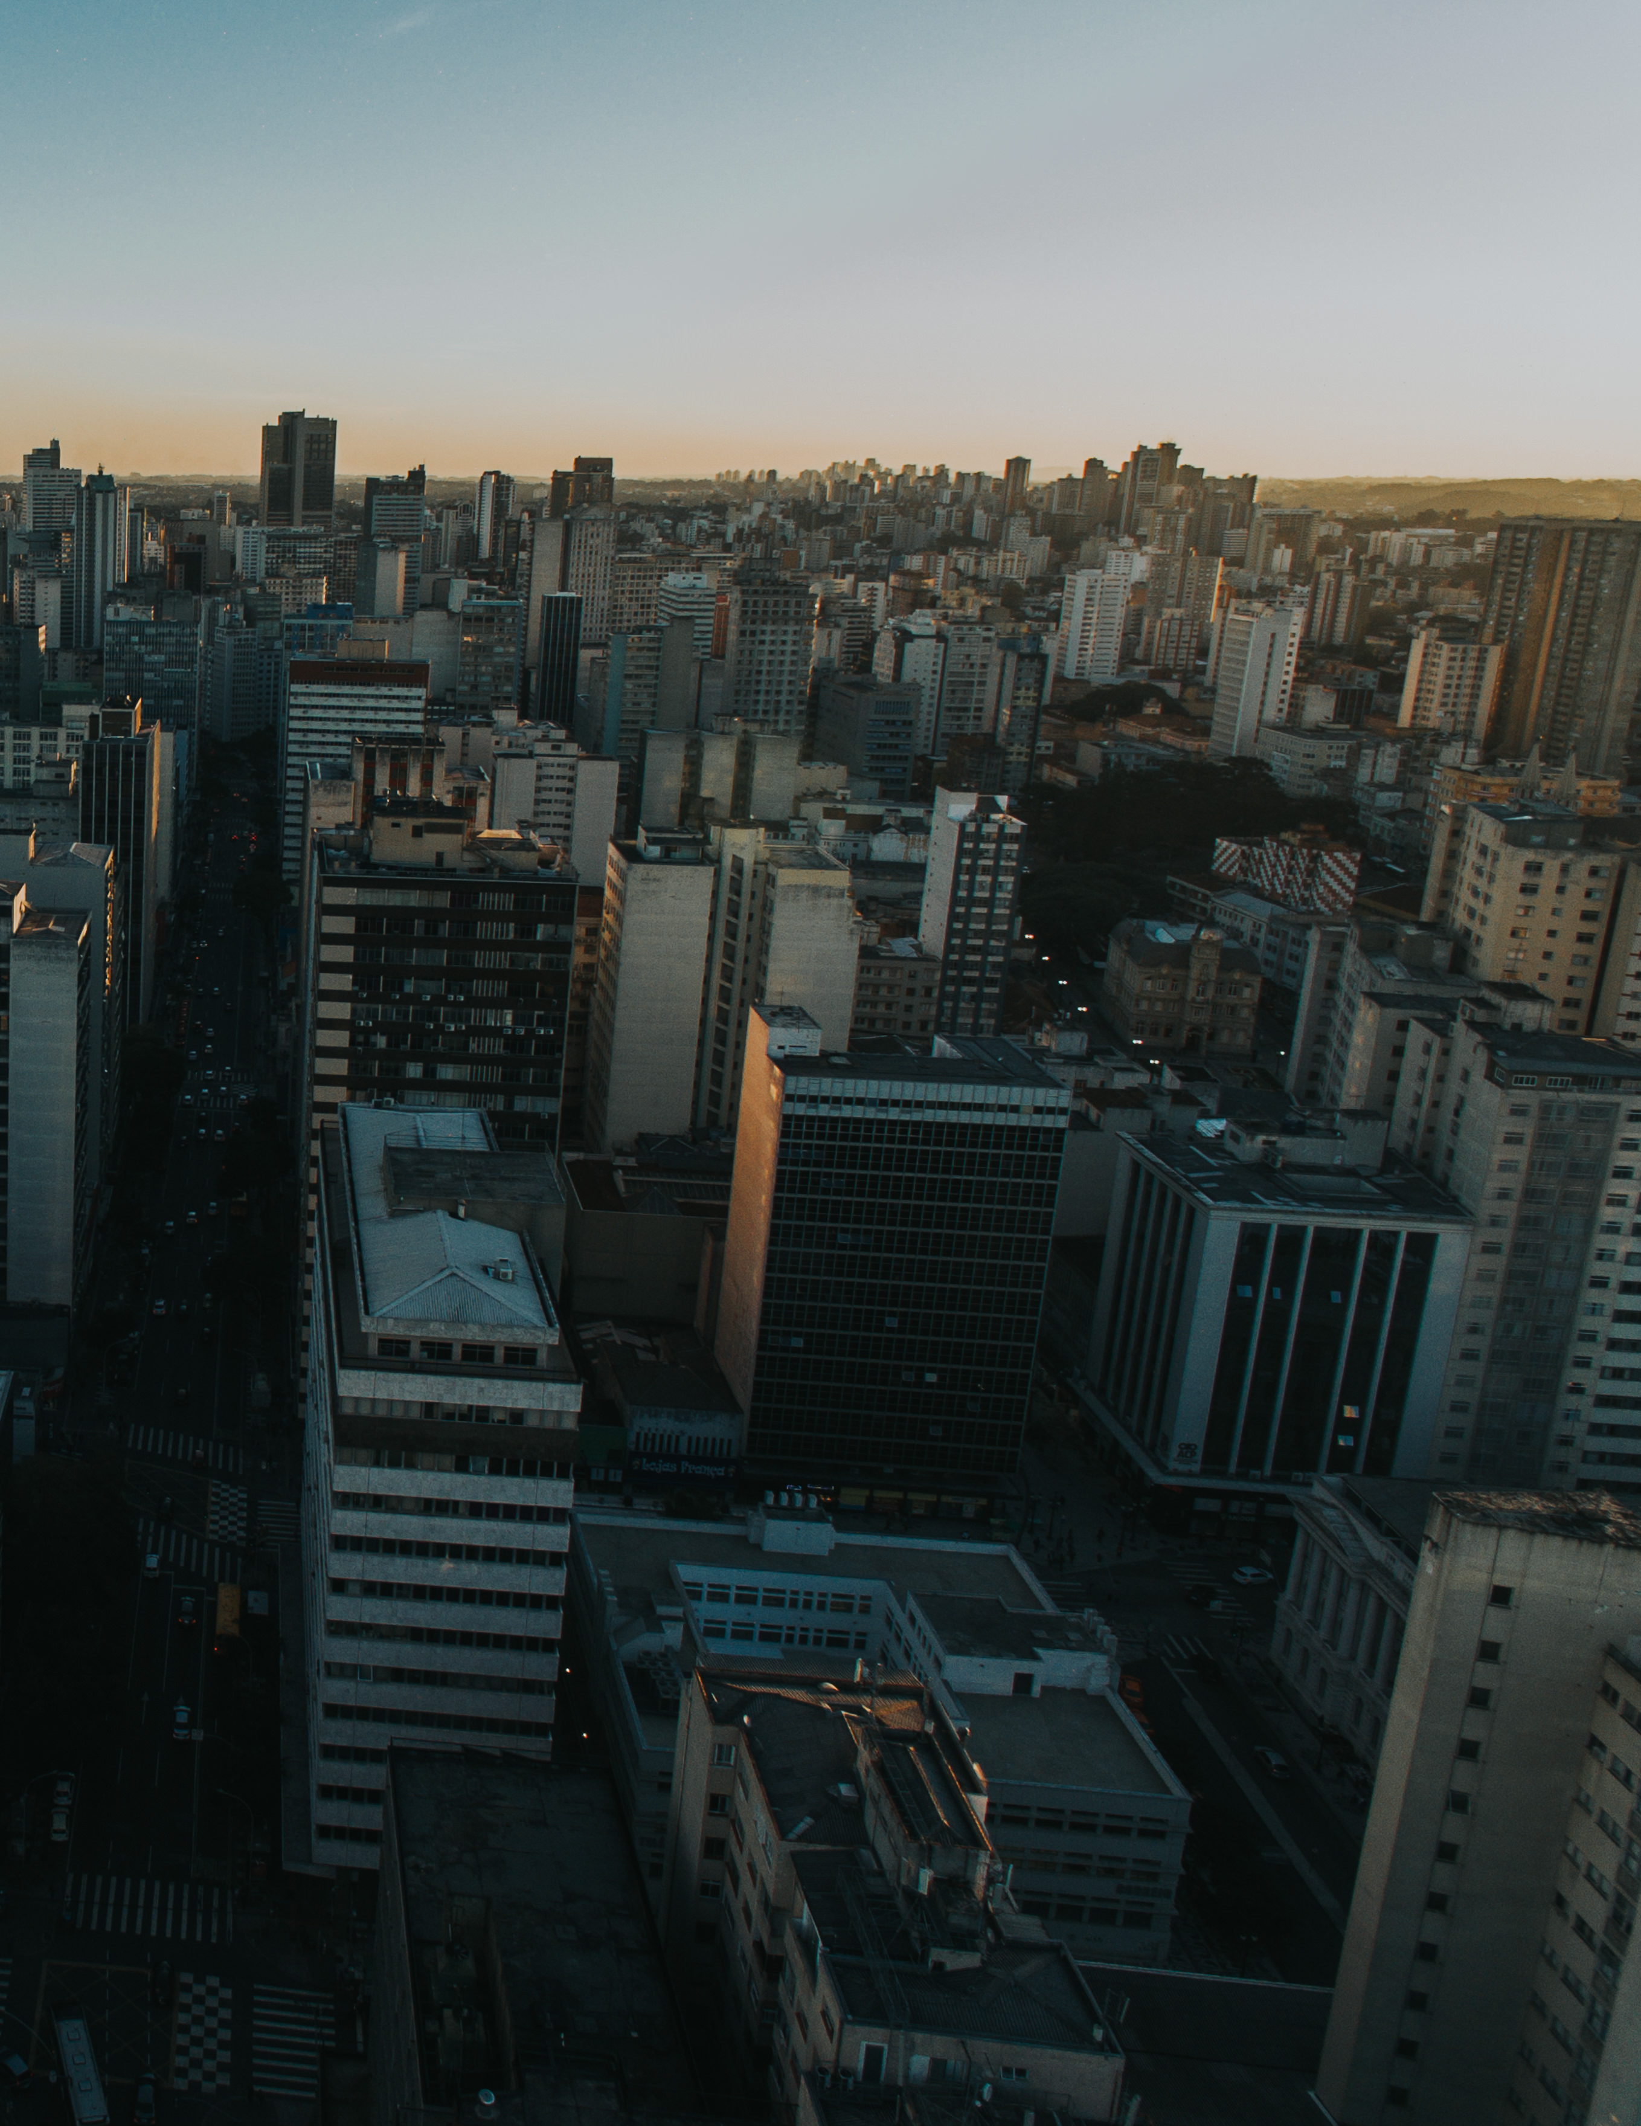

February 21, 2018
Kata #1
Pascal Case to Kebab Case

Slide 10
February 21, 2018
Kata #2
Convert Roman to Arabic Numerals

Slide 11

Thank You!
ebanx.com

